Slide 1
Petivity
Midway Milestone

Slide 2




MEET THE TEAM
Ivan Salinas
Sidra Ijaz
Crystal Zheng
Jonathan Mao
Notes:
People often have a difficult time completing tasks because of distractions, poor time management, and/or unhealthy work-life balance.

Slide 3
Value​ ​Prop,​ ​Problem​ ​and​ ​Solution​ ​Overview

Slide 4
Petivity
“Productivity’s Best Friend”
Problem: People often have a difficult time completing tasks because of distractions, poor time management, and/or unhealthy work-life balance.
Solution: We aim to increase productivity by effectively eliminating distractions and keeping people on track in a fun and engaging way.
Notes:
Productivtiy because most people can relate to it

Slide 5
Overview of Talk:
Heuristic Evaluation Results
Overview of Revised Design
Prototype Implementation Status
Demonstration of Prototype
Summary
Notes:
Heuristic evaluation results come from testing of medium-fi prototype
Addressed the issues brought up in the heuristic evaluation by revising our design
Prototype implementation status: what we’ve done so far as well as our plan for what we have left

Slide 6
Heuristic Evaluation Results
& proposed Revised changes

Slide 7
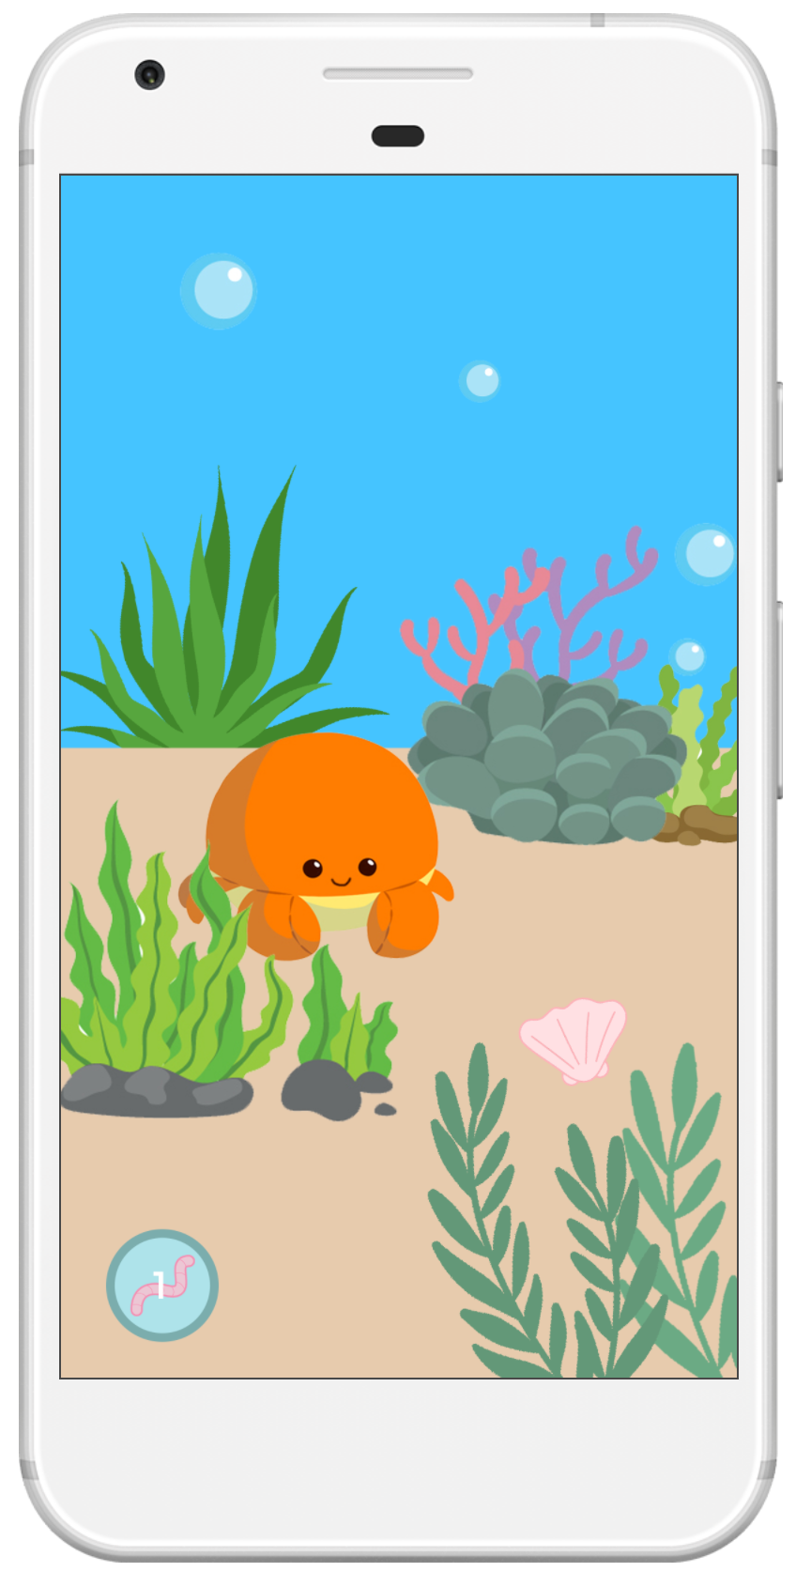
H10 Help and Documentation: Severity 4
Problem:
No user instructions on mobile home page after sign in
Solution:
Have a prompt once the user logs in so user knows where to tap in order to navigate to the block-timer page
Click me to Start Blocking
Notes:
Having a prompt upon log in makes it friendly to new users, as well as prevents annoyance of return users who don’t want to see the prompt every time.
No need for images of heuristic evaluation - makes the slide feel overwhelming with text

Slide 8
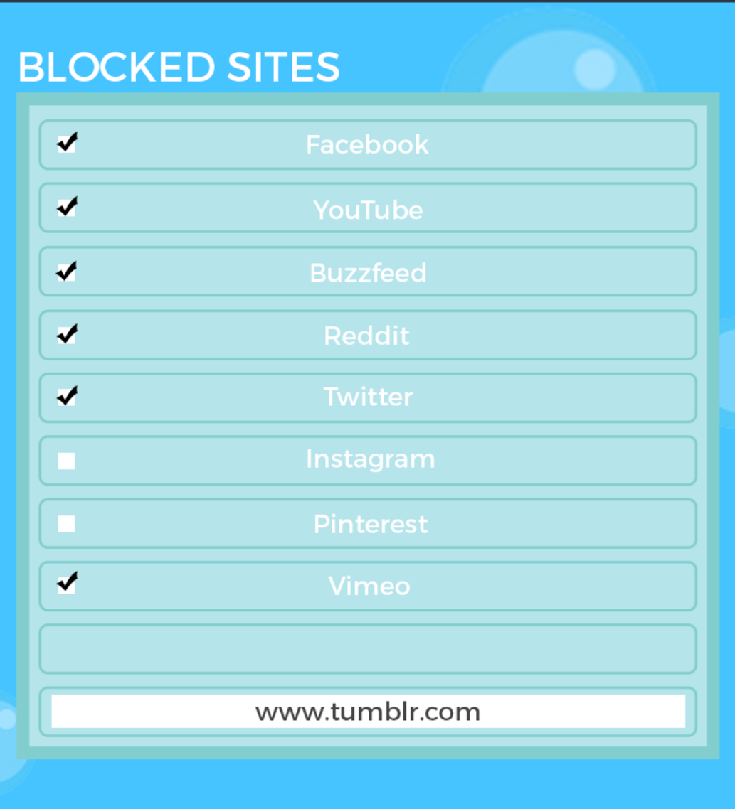
H5 Error Prevention: Severity 3
Problem:
Website’s Blocked Sites section does not check if URL is valid/handles error
Solution:
Implement check for valid input, if not have an error message to prompt input of a valid URL
Submit

Slide 9
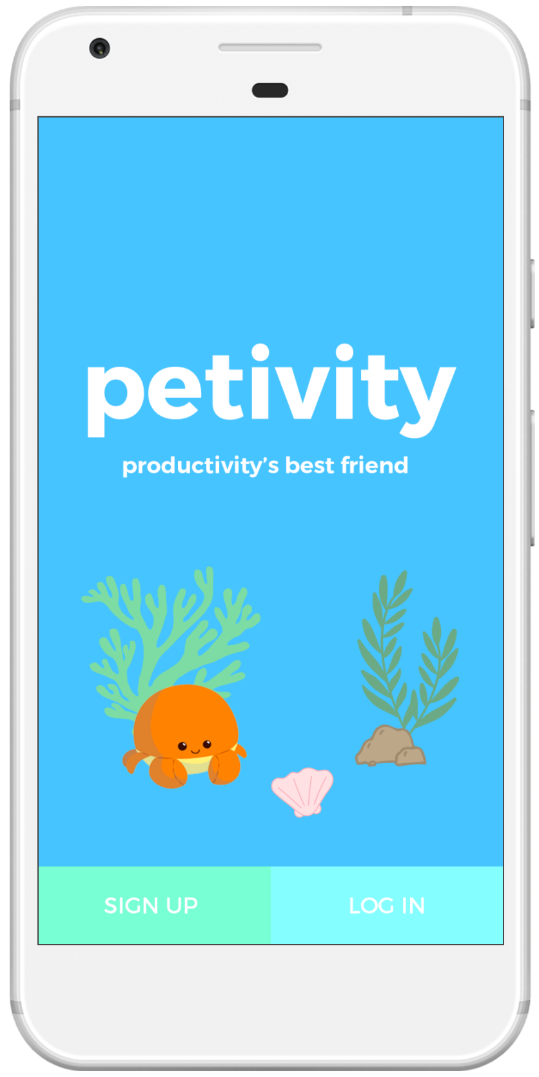
H4 Consistency and Standards: Severity 3
Problem:
No sign-in flow on web, while there is one on mobile
Solution:
Implement sign-in on web and on mobile

Slide 10
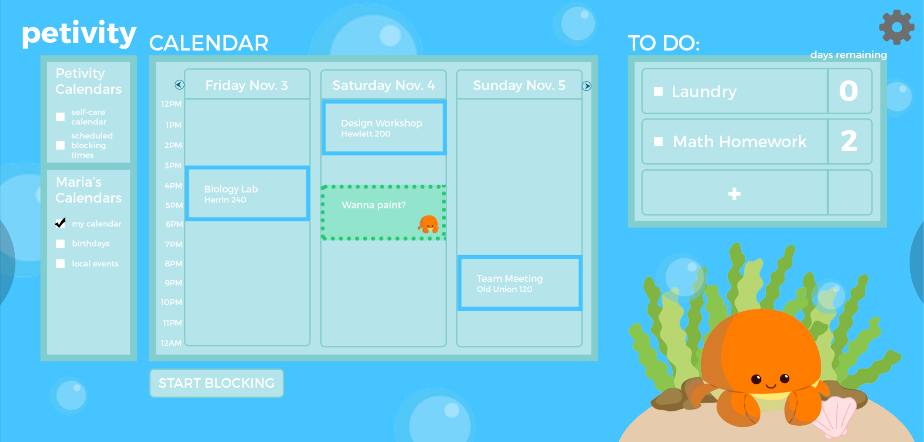
H1 Visibility of System Status: Severity 3
Problem:
Pet does not have a status state, no indication of progress
Solution:
Have the pet show emotion based on activity,as we did not agree with showing health points

Slide 11
H2 Match b/w System & World: Severity 3
Problem:
Confusion over what “Start Blocking” button does
Solution:
Change the button to “Start Blocking Now” to signify blocking will start immediately, have a short bubble that explains what it does when the user is new

Slide 12
Overview of other Revised Design changes
Be more clear & organized
Have more documentation and helpful messages
Slight changes in colors/overall design
Notes:
More clear and organized: word choice/wording of things as well as how to carry out tasks
More documentation and help because things like setting up the blocking feature can be difficult for new users
Disregarding some HE 1s and 2s because they are more stylistic choices rather than problems such as feeding the pet manually on mobile and automatically on web.

Slide 13
Prototype Implementation
Status

Slide 14
PROTOTYPE IMPLEMENTATION TOOLS
Mobile:
Expo XDE
ReactNative
Web:
Google Chrome Extension Developer Tools
GitHub
AngularJS & JavaScript
Bootstrap
Notes:
What is Expo XDE/Google Chrome Extension Development?

Slide 15
PROTOTYPE IMPLEMENTATION TOOLS
How the Tools Helped:
Google Chrome Extension Developer Tools allowed us to create the extension and try it out as it would appear
GitHub allowed members of our teams to collaborate and safely merge our changes
Bootstrap’s grid system allowed us to easily create a layout/structure for our web app
How the Tools Didn’t Help:
The tools did not teach our team how to code our necessary functions, nor how to set up everything for our code
Notes:
What is Expo XDE/Google Chrome Extension Development?

Slide 16
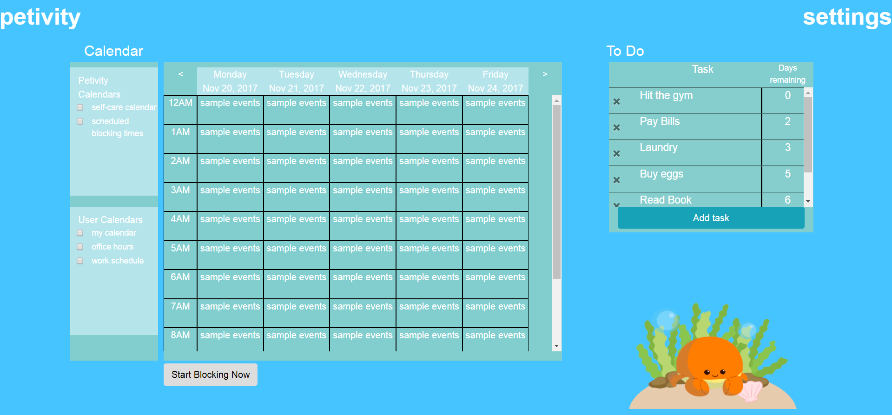
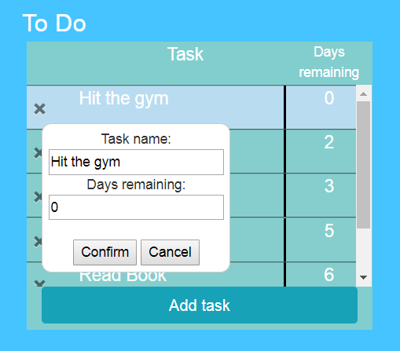
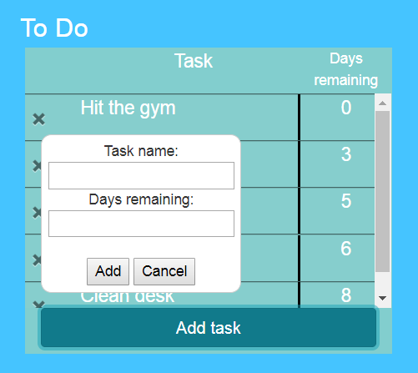
Implemented Features: Task Flow 1

Slide 17
Unimplemented Features Plan:
Yet to be Implemented:
A fully functional calendar (Blocking, self-care, etc.)
The settings page
Web blocking feature
Mobile blocking feature
Animations
Web Login Feature
Planned:
A pre-populated calendar from rows and columns, where you click/drag a place to add an event
Having options available to select to change blocked websites, etc.
Notes:
Productivtiy because most people can relate to it

Slide 18
Wizard of Oz Techniques
On Mobile:
The appearance of mobile and web syncing
On Web:
Self-care suggestions automatically appear once self-care calendar is chosen → simulating optimization of self-care suggestions using AI, based on time available, interests, past selections, etc.
Syncing with google calendar (unless we figure it out)
Notes:
Timing of blocking synced for mobile and web

Slide 19
Hard-coded Features and Why Required:
On mobile, we will hard-code:
The pet selected and environment
On web, will hard-code:
Previously added events
Previously added tasks
A pool of potential self-care activities
Why required? -
Mobile: Supposed to sync automatically to the web app where you can choose all these features
Web: Pre-populated information helps invoke the user to interact with the app in a more typical fashion, as opposed to a long initial setup phase.

Slide 20
issues/questions
On Mobile:
Still figuring out timer implementation
Syncing (have some ideas to try out, would love some more)
ReactNative tips/templates
On Web:
We are trying to figure out how to potentially integrate the calendar with Google Calendar
Animations for pet, background, etc.

Slide 21
Demonstration of prototype

Slide 22
summary

Slide 23
Summary:
Decided on most necessary changes for our webpage and app based on 3s and 4s in HE Evaluation
Made some other changes that we see fit (prioritizing functionality of task flows for main tasks)
We are on our way to completing our website and mobile app!

Slide 24

Thank You!
Any Questions?

